Slide 1
Oxygen therapy Devices
&
Manual Resuscitators
MODERATOR: Dr.Nikhila Priya
PRESENTER: Dr.M.Ramya Bhavana

Slide 2
Topics Covered
Definition of oxygen therapy
Indications for using oxygen therapy
Types of oxygen therapy
Administration of oxygen therapy
Complication of oxygen therapy

Slide 3
Definition of Oxygen Delivery System
Oxygen Delivery system is a device which is used to administer regulate and supplement oxygen to a subject to increase the arterial oxygenation.

Slide 4
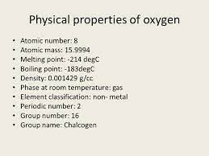
Physical Properties of Oxygen

Slide 5
Definition of O2 therapy
Oxygen therapy is the administration of oxygen at a concentration of pressure greater than that found in the environmental atmosphere.

Slide 6
Indications for Oxygen Therapy
Documented hypoxemia
Acute care situations in which hypoxemia is suspected
Severe trauma
Acute myocardial infarction
Short term therapy (Post anaesthesia recovery)
Increased metabolic demands, i.e. burns, multiple injuries, and severe infections.

Slide 7
Documented hypoxemia
In adults, children, and infants older than 28 days:
PaO2 of < 60 mmHg or (SaO2) of < 90% in room air
or
PaO2 and/or SaO2 below desirable range for specific clinical situation
In neonates: PaO2 < 50 mmHg
SaO2 < 88%
capillary oxygen tension (PcO2) < 40mmHg

Slide 8
Oxygen Flux and Requirements
The supply of oxygen is dependent upon the hemoglobin (Hb), O2 saturation % (SaO2) and cardiac output (Q in mL/min).
"Oxygen flux" denotes the total amount of oxygen delivered to the body per minute and is given by the equation:
Oxygen flux = 1.34 x Hb in g/dL x (SaO2/100) x Q/100

Slide 9
Assessment
The need for oxygen therapy should be assessed by:
1.Clinical assessment findings.
2.Measurement of inadequate oxygen saturations by
non-invasive methods like Pulse oximetry
invasive or Arterial blood gas monitoring( PaO2, SpO2)

Slide 10
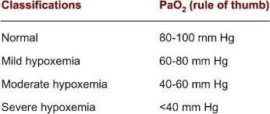
GRADING OF HYPOXIA
Respiratory failure

Slide 11



TYPES OF HYPOXIA
Types
Definintion
Typical cases
Hypoxic
oxygen tension
High altitude – hypoventilation – V/Q mismatch.
Anemic
carrying capacity
Anemia – blood loss – CO poisoning
Stagnant
perfusion
Heart failure – Shock – ischemia
Histotoxic
Cellular hypoxia
Cyanide – other metabolic poisons – shifting of O2-HB curve.

Slide 12
Benefits of O2 therapy in Hypoxia
Hypoxic hypoxia
Anaemic hypoxia
Stagnant hypoxia
Histotoxic hypoxia
+ + +
+
+
-

Slide 13
Factors that determine which system to use:
Patient comfort / acceptance
The level of FiO2 that is needed
The requirement that the FiO2 be controlled within a certain range
The level of humidification and /or nebulization
Minimal resistance to breathing
Efficient & economical use of oxygen

Slide 14
Classification of Oxygen Delivery Systems
Low flow systems
Which contribute partially to the inspired gas
High flow systems
Which deliver specific and constant percent of oxygen independent of client’s breathing

Slide 15
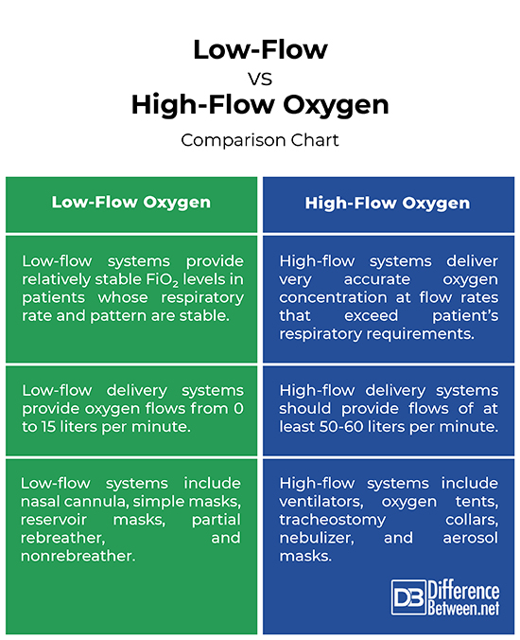
Oxygen Devices Classification

Slide 16
Oxygen therapy devices
Variable performance devices:
FiO2 depends on: O2 flow, Patient factors and Device factors
No capacity – nasal catheters, cannulae
Small capacity – masks
Large capacity – mask with bag
Fixed performance devices
HAFOE systems (High air flow oxygen enrichment device
» Venti Mask
Anaesthesia circuits
Ventilators

Slide 17
Nasal Catheter

Slide 18
Nasal Catheter
Design
• Comprises a single lumen catheter lodged in the anterior nares.
• Appears like suction catheter with multiple openings at distal end.
• Foam collar helps to lodge the catheter in the anterior nares.
• Sizes: 8-14 FR
Use
• Tip of the catheter to be inserted upto fold of soft palate.
• Catheter is slowly pulled back so that the tip lies beyond posterior nares above uvula.
• Has to be changed from one nostril to the other every 8 hours.
• Flow rates upto 3L/min in conscious patient.
• Upto 40% Fi O2 may be delivered.

Slide 19
Nasal Catheter
Merits:
• Easy to fix
• Keeps hands free
• Not much interference with further airway care
• Useful in both spontaneous breathing and apnoeic period.
Demerits:
• Mucosal irritation (uncomfortable)
• Gastric dilatation (especially with high flows)

Slide 20
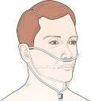
Nasal Prongs
It is disposable.
Plastic devise with two protruding prongs for insertion into the nostrils, connected to an oxygen source.
Used for low-medium concentrations of Oxygen (24-44%).

Slide 21
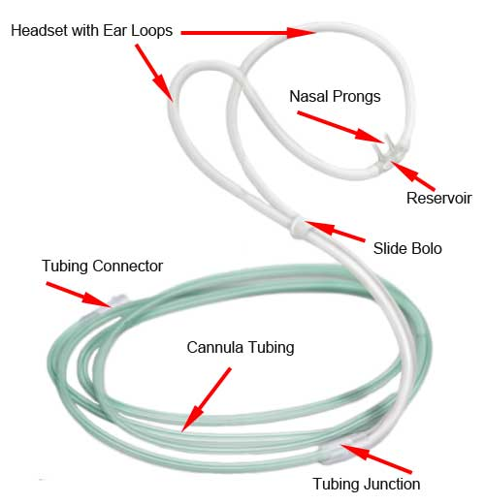

Slide 22
Disadvantages | Advantages | reservoir | Amount Delivered F1o2 (Fraction Inspired Oxygen)
may cause irritation to the nasal and pharyngeal mucosa if oxygen flow rates are above 6 liters/minute Variable FIO2 | Client able to talk and eat with oxygen in place Easily used in home setting | Nasopharynxdead space 50ml | Low flow 24-44 % 1 L\min=24% 2 L\min=28% 3 L\min=32% 4 L\min=36% 5 L\min=40% 6 L\min=44% | Nasal prongs

Slide 23
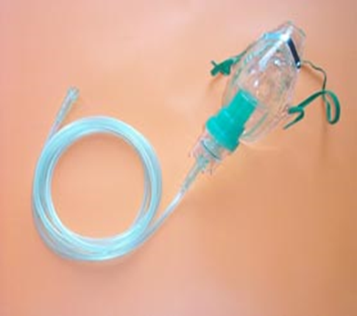
Face Mask
Types of face mask:
Simple Oxygen mask
Partial rebreather mask
Non rebreather mask
Venturi mask

Slide 24
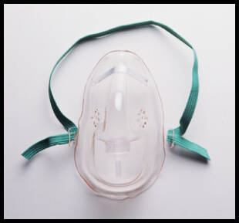
Simple Oxygen mask

Slide 25
The Simple Oxygen Mask
Made of clear, flexible , plastic or rubber that can be molded to fit the face.
It delivers 35% to 60% oxygen.
A flow rate of 6 to 10 liters per minute.
Often it is used when an increased delivery of oxygen is needed for short periods(i.e.< 12 hours).

Slide 26
Disadvantages | Advantages |  | Amount Delivered F1o2 (Fraction Inspired Oxygen)
Tight seal not present,air leak, mixed room air (lower FiO2) Limited FiO2 (Max 60%) Pt demand not met in some cases Difficult to keep mask in position in some cases Potential for skin breakdown (pressure, moisture) Uncomfortable for pt while eating or talking Expensive compared to nasal tube | Can provide increased delivery of oxygen for short period of time Higher FiO2 compared to nasal prong Can use venture Can use nebulizer | Flow not < 5 L/ min-CO2 retention No reservoir bag | Low Flow 6-10 L\min 35%-60% | Simple mask

Slide 27
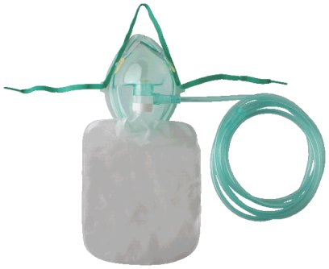
Partial Rebreather Mask
The mask is has a reservoir bag that must remain inflated during both inspiration & expiration
It is used to deliver oxygen concentrations up to 80%.
The oxygen flow rate must be maintained at a minimum of 6 L/min to ensure that the patient does not rebreathe large amounts of exhaled air.
The remaining exhaled air exits through vents.

Slide 28
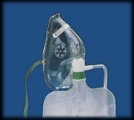
Partial Rebreather Mask

Slide 29
Disadvantages | Advantages |  | Amount Delivered F1o2 (Fraction Inspired Oxygen) | Method
Requires tight seal (eating and talking difficult, uncomfortable Not as drying to mucous membranes | Patient can inhale room air through openings in mask if oxygen supply is briefly interrupted | Flow rate must be such that the mask remains 2/3 full during inspiration Reservoir bag must be free of twists or kinks | Low Flow 6 L\min 75%-80% oxygen | Partial Rebreather Mask

Slide 30
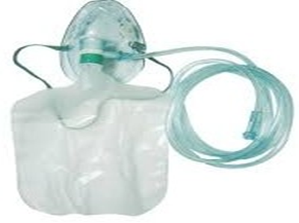
Non Rebreather Mask
This mask provides the highest concentration of oxygen (95-100%) at a flow rate 6-15 L/min.
It is similar to the partial rebreather mask except two one-way valves prevent conservation of exhaled air.
The bag is an oxygen reservoir

Slide 31
Disadvantages | Advantages | Priority Nursing Interventions | Amount Delivered F1o2 | Method
Impractical for long term Therapy Malfunction can cause CO2 buildup suffocation Expensive Feeling of suffocation Uncomfortable Costly | Delivers the highest possible oxygen concentration Suitable for pt breathing spontaneous with sever hypoxemia | Maintain flow rate so reservoir bag collapses only slightly during inspiration Check that valves and rubber flaps are function properly (open during expiration ) Monitor SaO2 with pulse oximeter | Low Flow 6-15 L \min 80%-100% | Non rebreather MASK

Slide 32
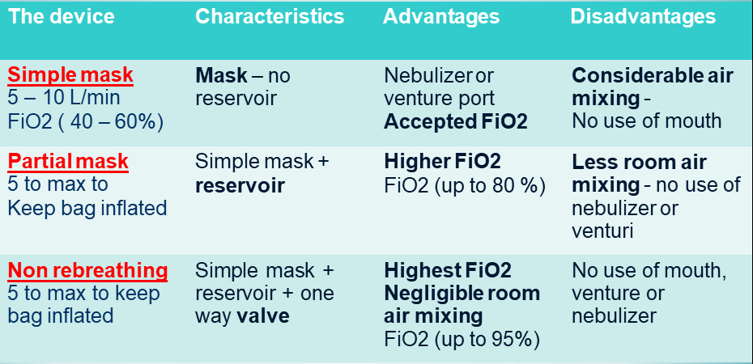

Slide 33
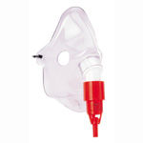
Venturi mask
It is high flow concentration of oxygen.
Oxygen from 40 - 50%
At liters flow of 4 to 15 L/min.

Slide 34
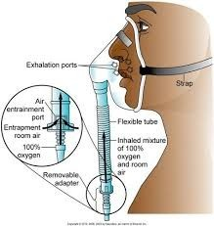
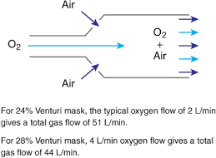
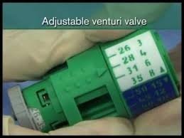
Venturi mask

Slide 35
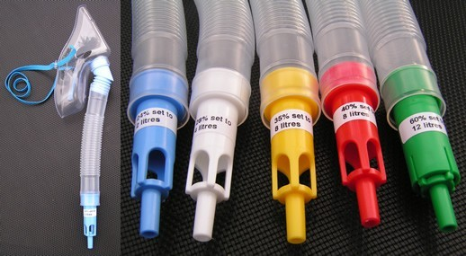
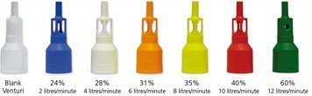
Venturi mask

Slide 36
 | Venturi valve
Color | FiO2 | O2 Flow
Blue | 24% | 2 L/min
White | 28% | 4 L/min
Orange | 31% | 6 L/min
Yellow | 35% | 8 L/min
Red | 40% | 10 L/min
Green | 60% | 15 L/min

Slide 37
Disadvantages | Advantages |  | Amount Delivered Fio2 | Method
uncomfortable Risk for skin irritation Ignores patient O2 demand and can produce respiratory depression in COPD patient when high oxygen concentration (>50%) is used | Delivers most precise oxygen concentration Doesn’t dry mucous membranes (humidity | Adjustable valve Use simple mask or CPAP | Oxygen from 40-- 50% Flow 4 to 15 L/min. | Venturi Mask

Slide 38
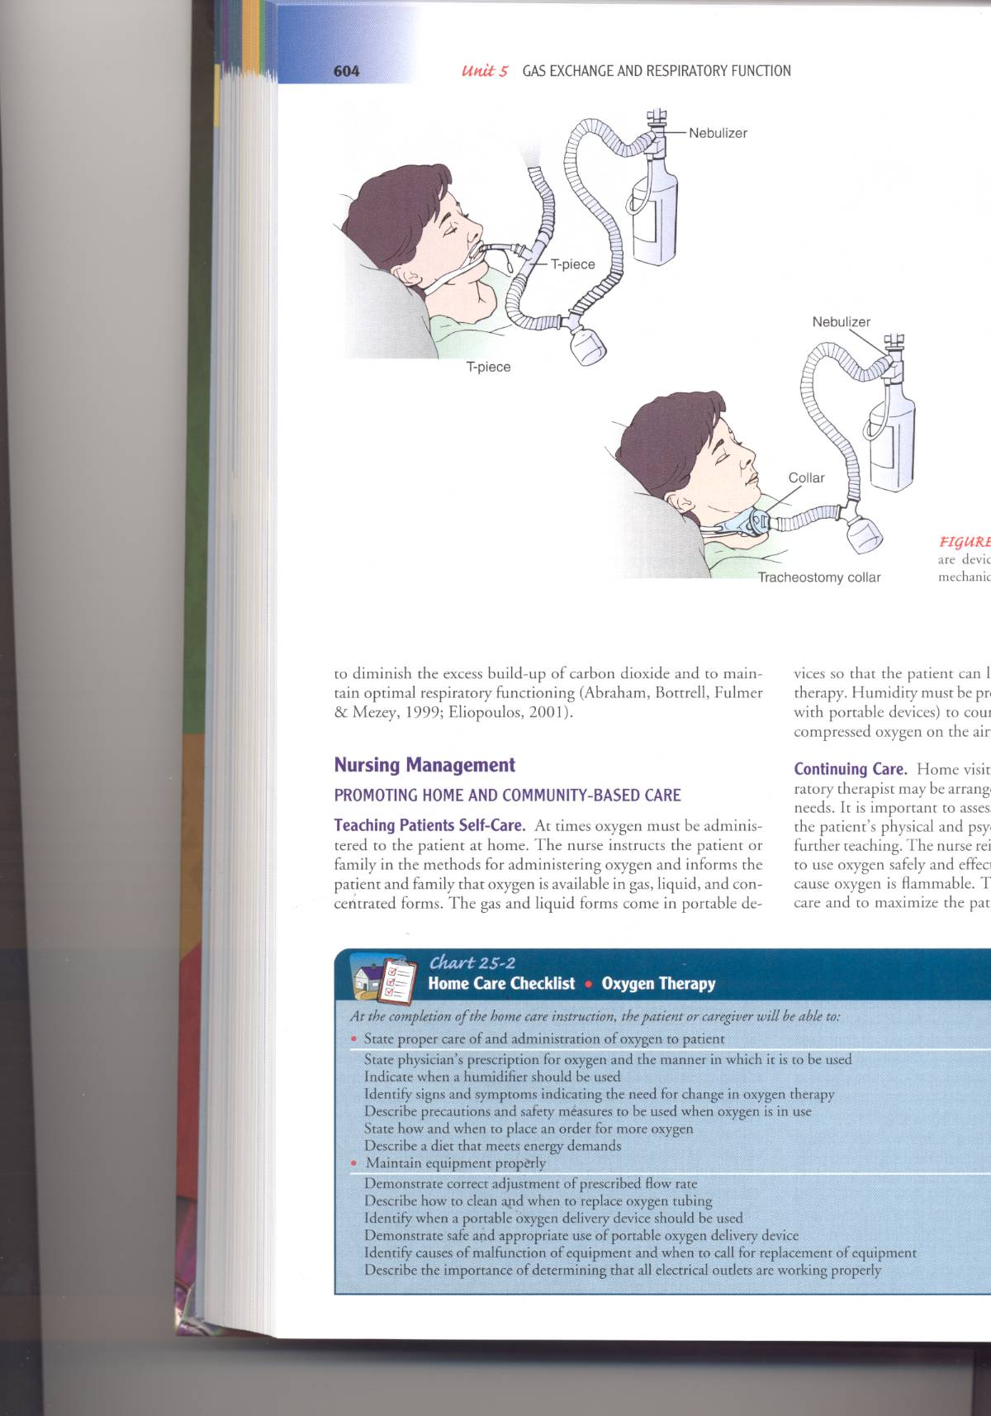
T-piece
Used on end of ET tube when weaning from ventilator
Provides accurate FIO2
Provides good humidity

Slide 39
Trach Collar
High flow device
Provides O2 or humidified room air to trach
Settings similar to Venturi mask

Slide 40
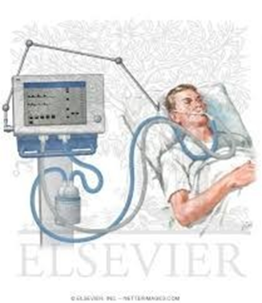
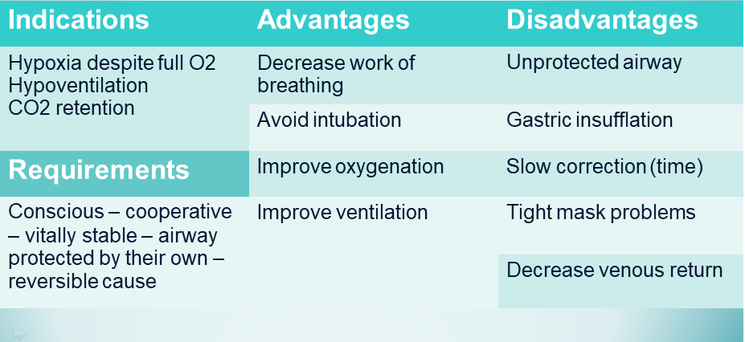
Positive pressure ventilation

Slide 41
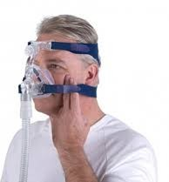
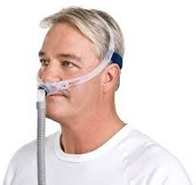
Positive pressure ventilation
Dyspnic mouth breather.
More dead space and Clustrophobia
Can use mouth
Less dead space and Claustrophobia

Slide 42
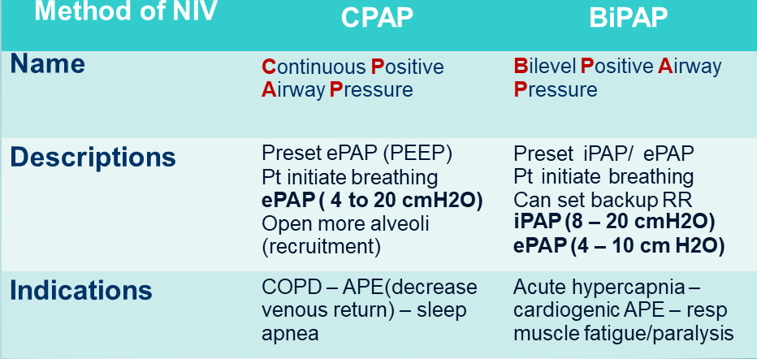
Positive pressure ventilation

Slide 43

Oxygen Toxicity
It is interesting that while o2 is necessary for life in aerobic organisms, it is also toxic.
1878 -Paul Bert: The Father of Pressure Physiology observed convulsions and death in animals at a constant 3-4 atmospheres of pressure.

Slide 44
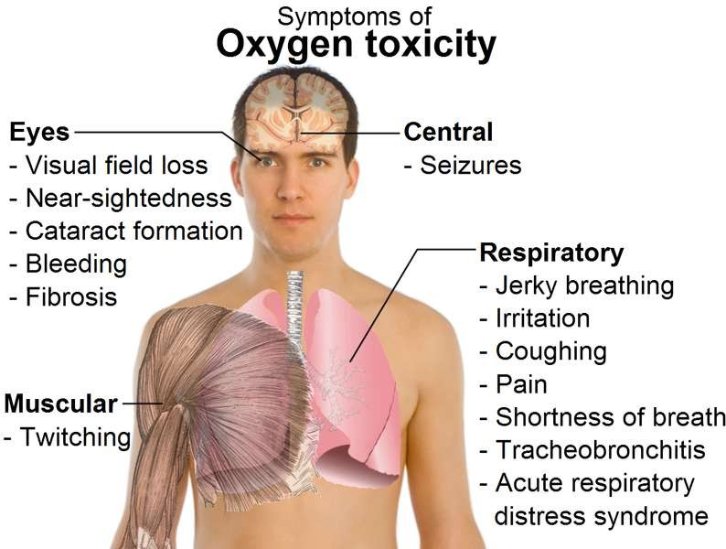

Slide 45
How much O2 is safe?
100% -not more than 12hrs
80% -not more than 24hrs
60% -not more than 36hrs
Goal should be to use lowest possible FiO2 compatible with adequate tissue oxygenation

Slide 46
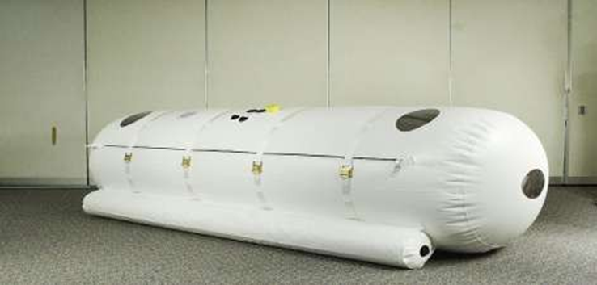
Hyperbaric Oxygen Therapy

Slide 47
Definition
The intermittent administration of 100% Oxygen at higher than atmospheric pressure, i.e. where oxygen dissolves in arterial blood plasma in increased amounts.

Slide 48
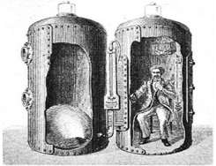
History
Initial discovery:
In 1662 → Henshaw built first hyperbaric chamber
Henshaw’s
Domicilium

Slide 49
1870-Surgical use → Fontaine & Bert Used for Wounds
1889 – Moir,Reduced mortality rate of decompression sickness from 25% to only 1.6% per year.
1960 – BOEREMA,Pioneered the application of HBO to many medical problems.Performs first surgery with HBO.Discovered that Hgb wasn’t necessary for O2 transport
Brummelkamp discovered effects on anaerobes

Slide 50
Physiology
Normally ,O2 demand is met by the Oxygen combined to Hb, which is 95% saturated.
Even if we increase the pO2 , hemoglobin can’t carry more oxygen as it is 100% saturated.
100 ml blood carries 19 ml O2 combined with Hb and 0.32 ml dissolved in plasma.
Under barometric pressures,more oxygen gets dissolved into plasma,this additional O2 is almost sufficient to meet tissue needs without contribution from O2 bound to hemoglobin and is responsible for the beneficial effects of this therapy.

Slide 51
Effect of Pressure On Arterial O2
Content of Oxygen Dissolved in plasma (voL)
total pressure Breathing Air % 100 Oxygen
1 | 0.32 | 2.09
2 | 0.81 | 4.44
3 | 1.31 | 6.80

Slide 52
Mechanism for HBO Therapy
Oxygenation of Ischemic, Hypoxic Tissue:
HBO increases plasma and tissue oxygen tensions 10 times which helps tissues to maintain tissue viability.
Neutrophil Oxidative Killing:
Neutrophils regain ability to kill bacteria by generation of oxygen dependent superoxides and peroxides.
Suppression of multiplication in bacteria:
High oxygen tensions suppress growth of streptococcus and anerobes.

Slide 53
Augmentation of Antibiotic effectiveness:
Increased oxygen tension allows oxygen dependent active transport to bring in antibiotic across bacterial cell wall.
Enhanced fibroblast function:
prevents unnecessary cicatrix formation.
Angiogenesis:
Increased oxygen tension increases vascular endothelial grow factor function as well as secretion of matrix by fibroblasts

Slide 54
Process Of Treatment
Initial compression for 30 minutes
Treatment for 90 minutes with air breaks (10 minutes every 30 minutes is standard)
Decompression for 30 minutes
All regimens use 100% O2
Pressure -Most use 2.4 atm
Maximum tolerated is 3 atm
4 atm induces seizures

Slide 55
Indications for HBOT
After reviewing all the scientific evidence available to date, the Undersea and Hyperbaric Medical Society, in its latest publication, Hyperbaric Oxygen Therapy Indications (12th ed.), recommends the following 13 indications for HBOT:
1.Air or gas embolism
2.Carbon monoxide poisoning and carbon monoxide +CYANIDE poisoning
3.Clostridial myositis and myonecrosis (gas gangrene)
4.Crush injury, compartment syndrome and other acute
traumatic ischemias

Slide 56
5.Decompression sickness
6.Arterial insufficiency ulcers
7.Severe anemia
8.Intracranial abscess
9.Necrotizing soft tissue infections
10.Osteomyelitis (refractory)
11.Delayed radiation injury (soft tissue and bony necrosis)
12.Compromised grafts and flaps
13.Acute thermal burn injury

Slide 57
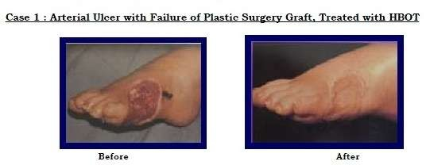

Slide 58
Contraindications
ABSOLUTE: Pneumothorax
RELATIVE :
DRUGS: Alcohol, Nicotine, Cis-platinum, Doxorubicin, Bleomycin, Aromatic hydrocarbons, Disulfiram, Steroids
History of spontaneous pneumothorax or thoracic surgery
Claustrophobia
COPD/URTI
Seizure disorders
Hyperthermia/Hypothermia
Other conditions: Malignant tumors, Acidosis, Pregnancy, Hereditary spherocytosis, Optic neuritis

Slide 59
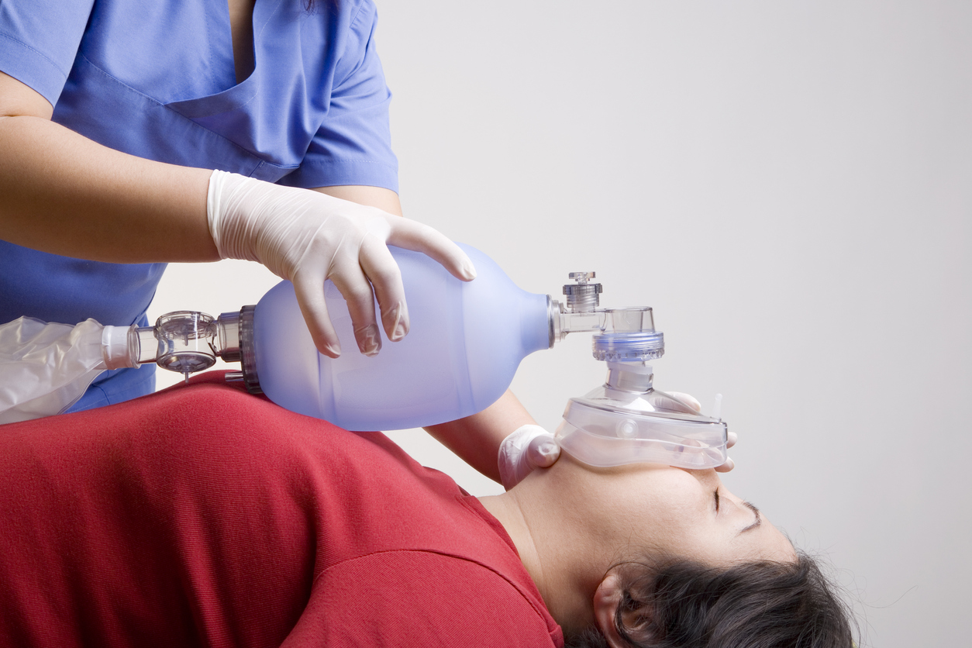
Manual resuscitator

Slide 60
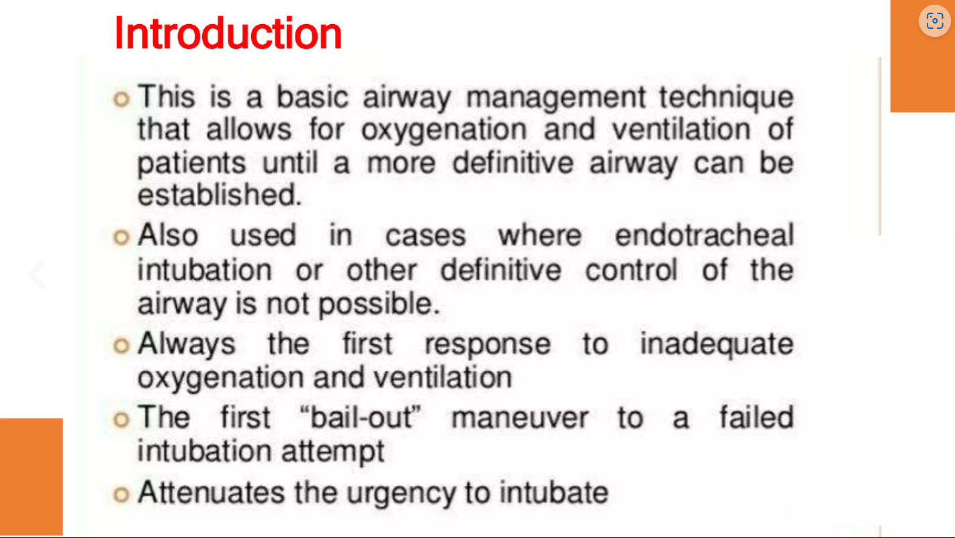
AMBU Bag ( Artificial Manual Breathing Unit)

Slide 61
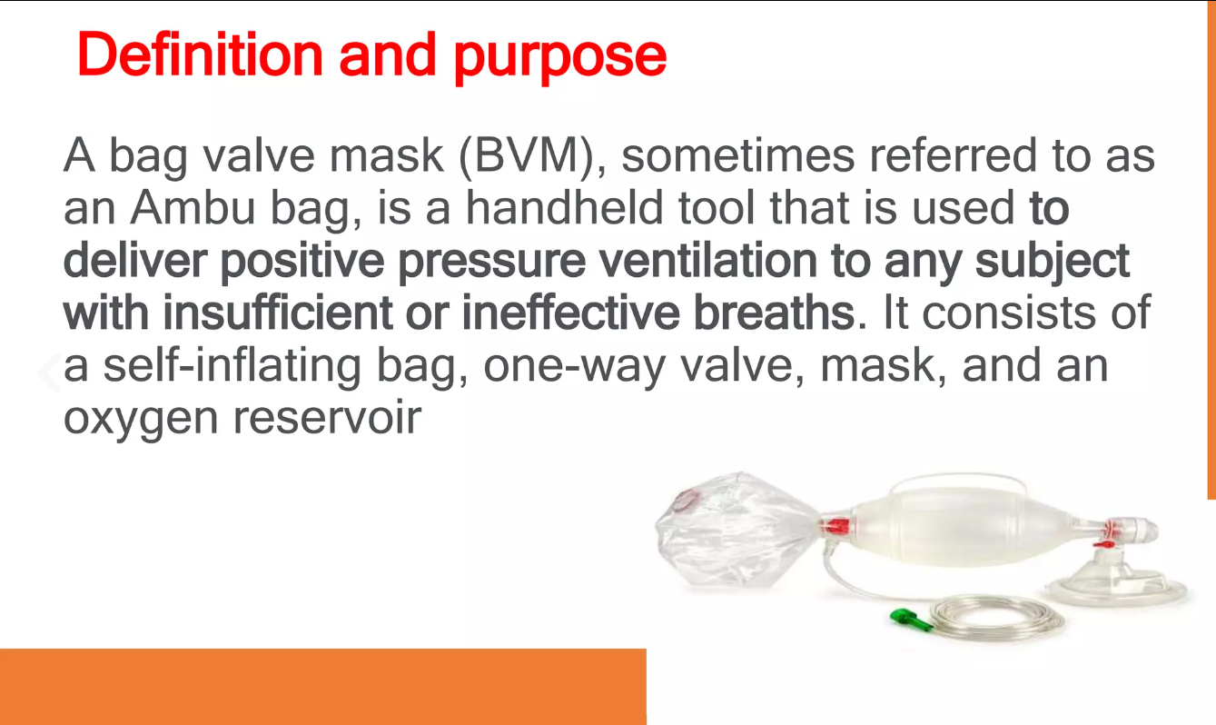

Slide 62
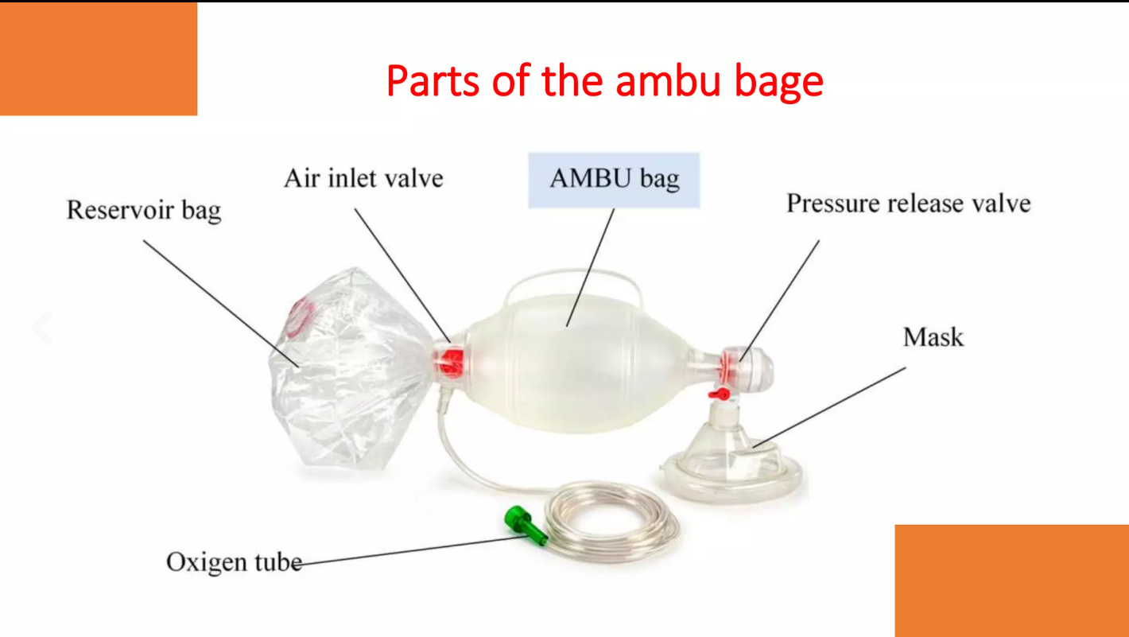

Slide 63
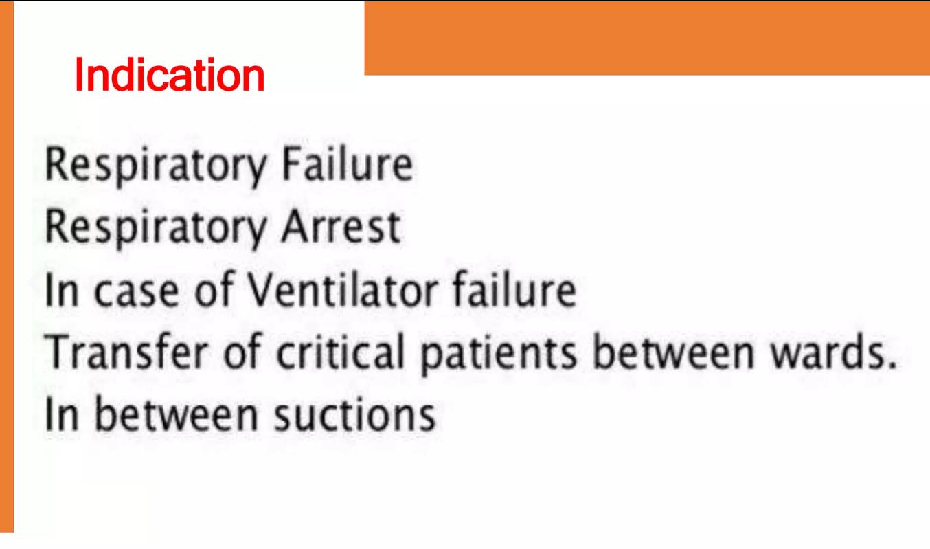

Slide 64
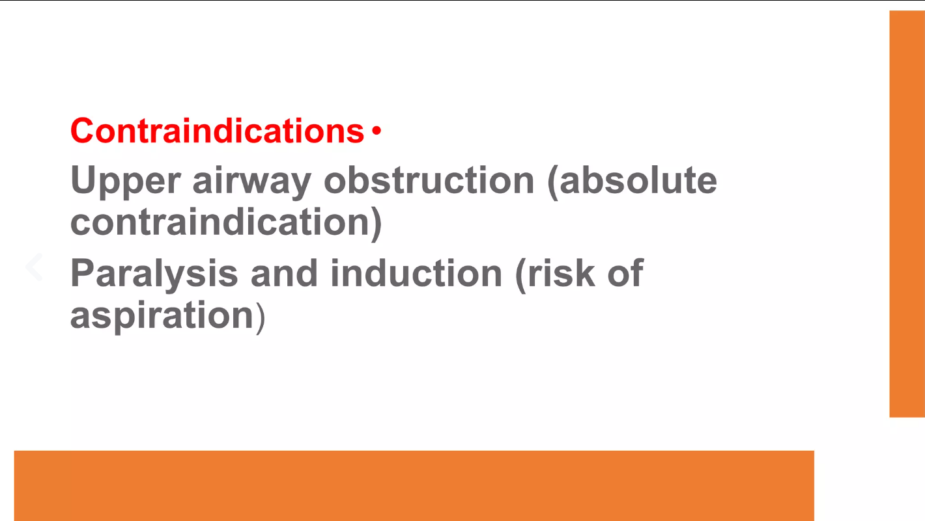

Slide 65
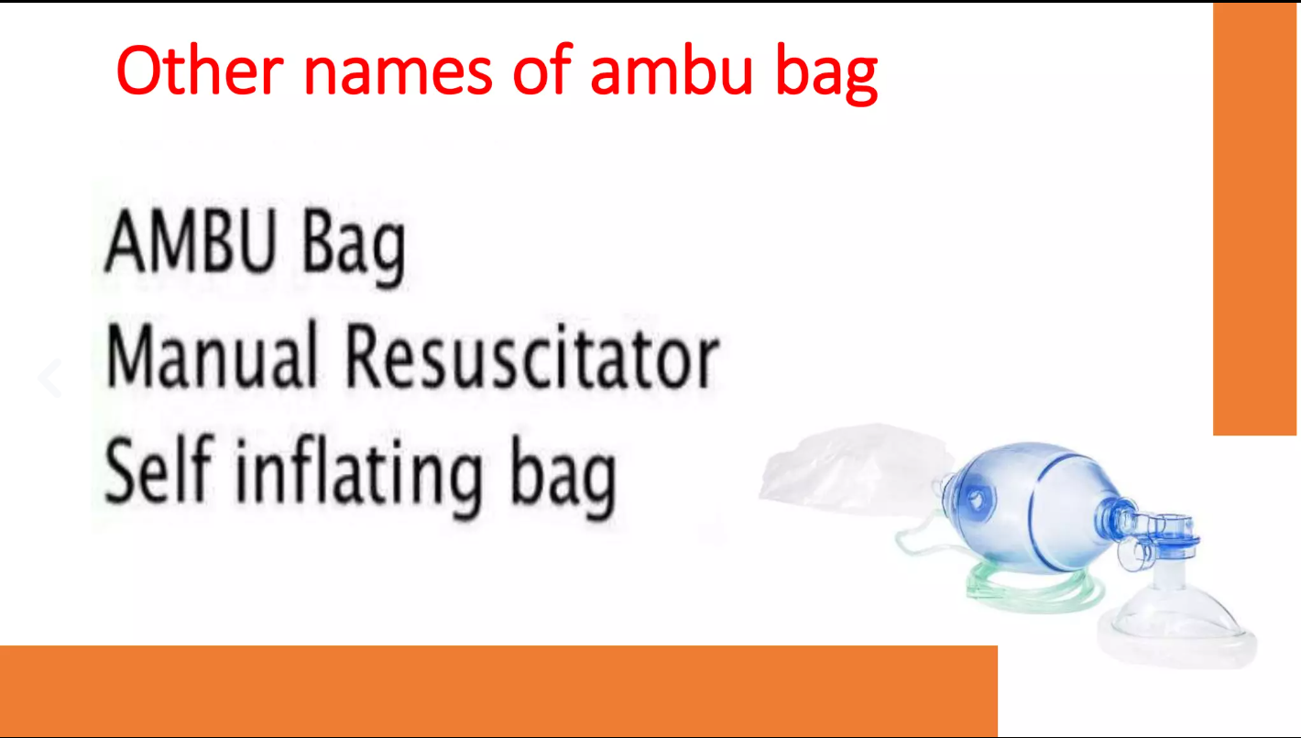

Slide 66
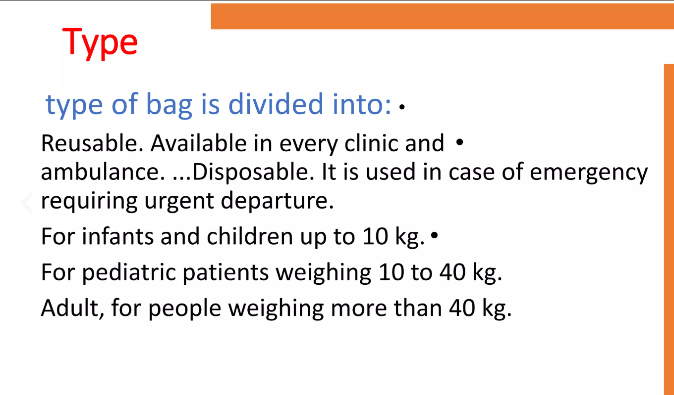

Slide 67
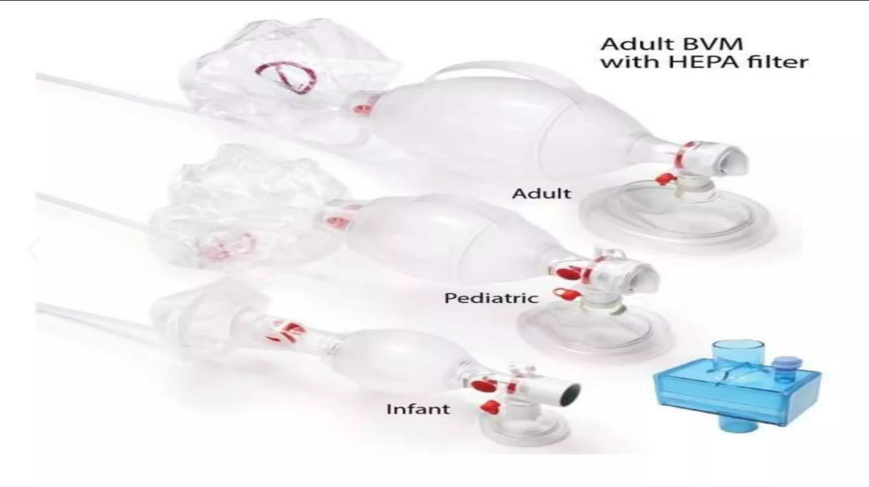

Slide 68
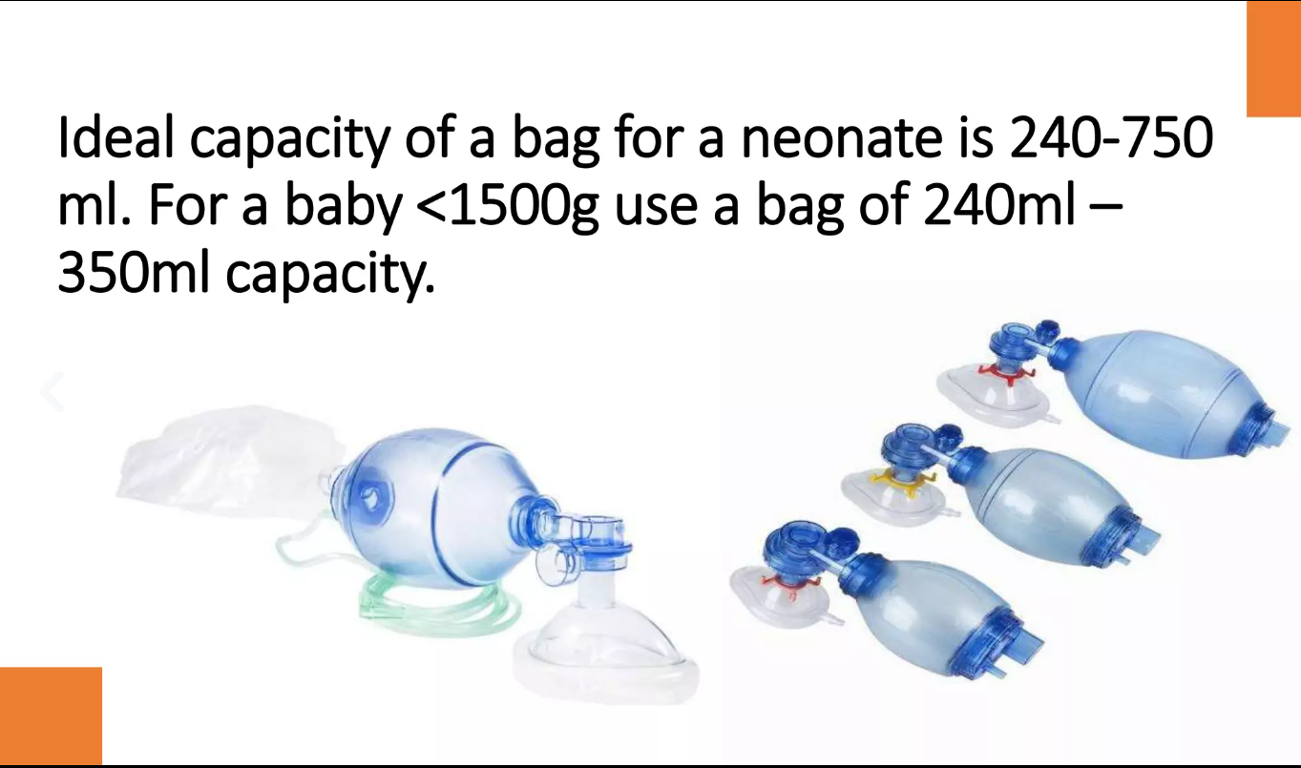

Slide 69
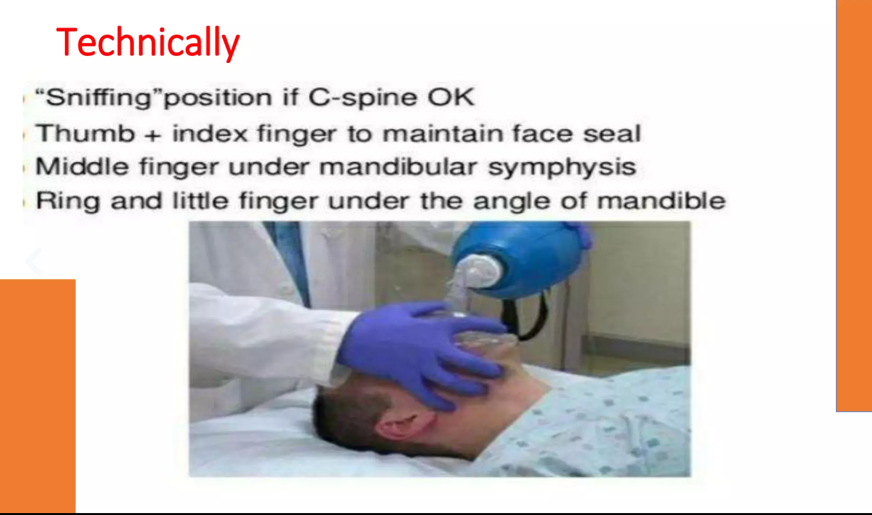

Slide 70
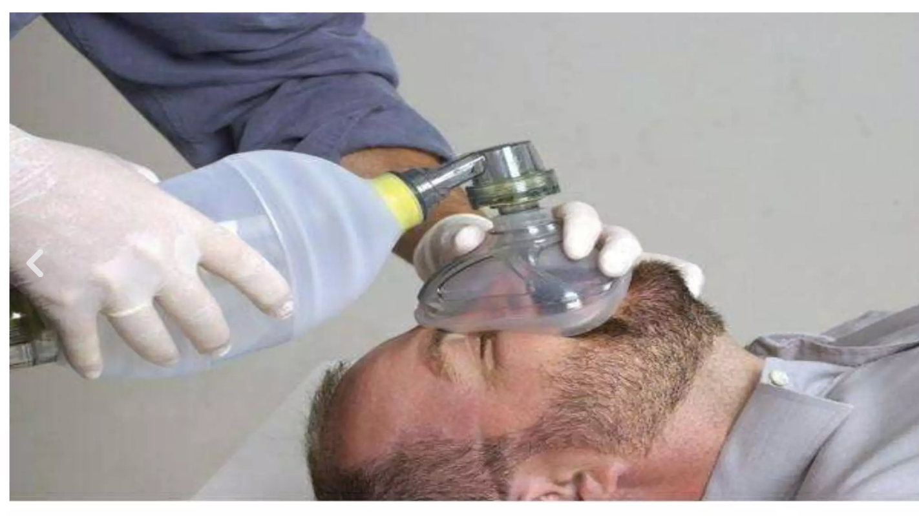

Slide 71
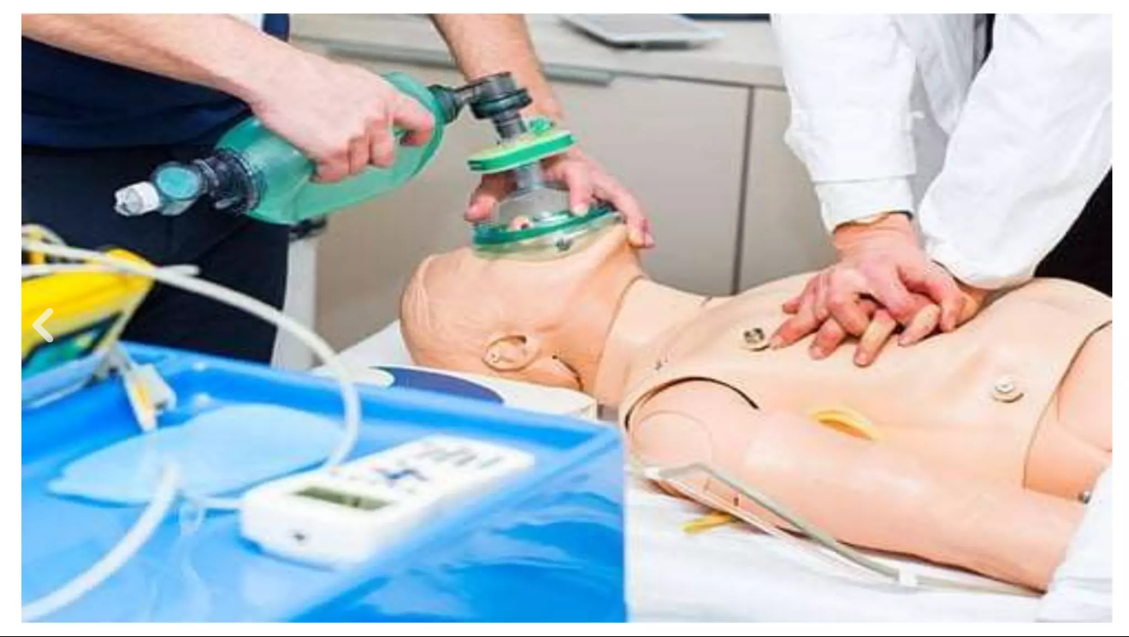

Slide 72
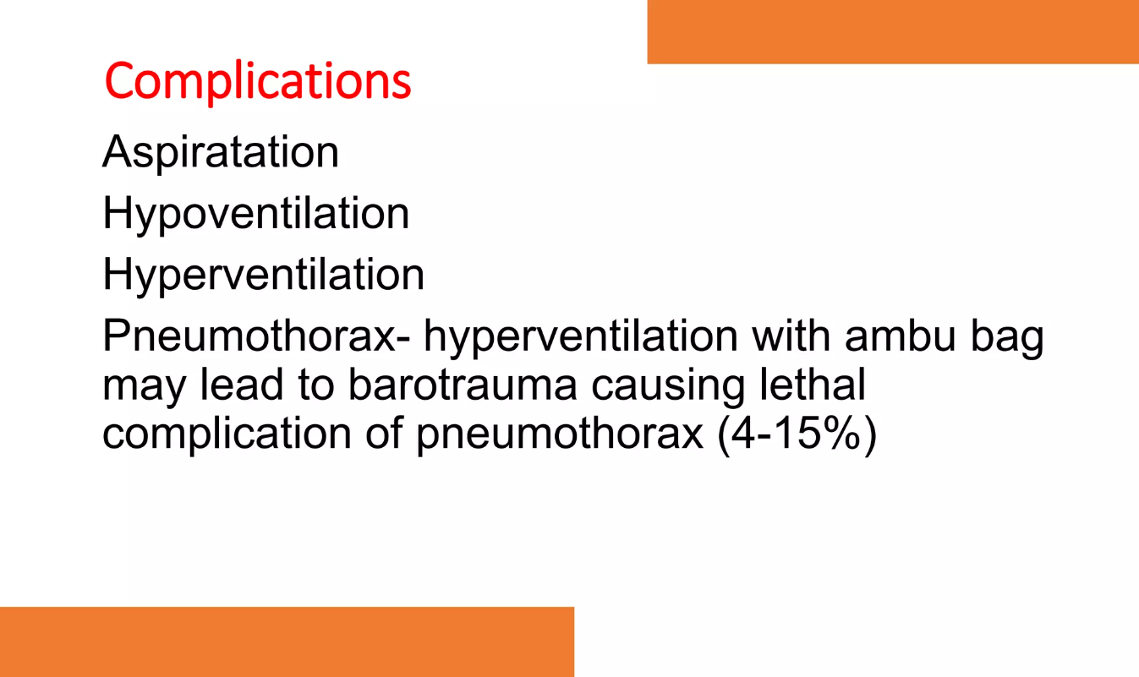

Slide 73
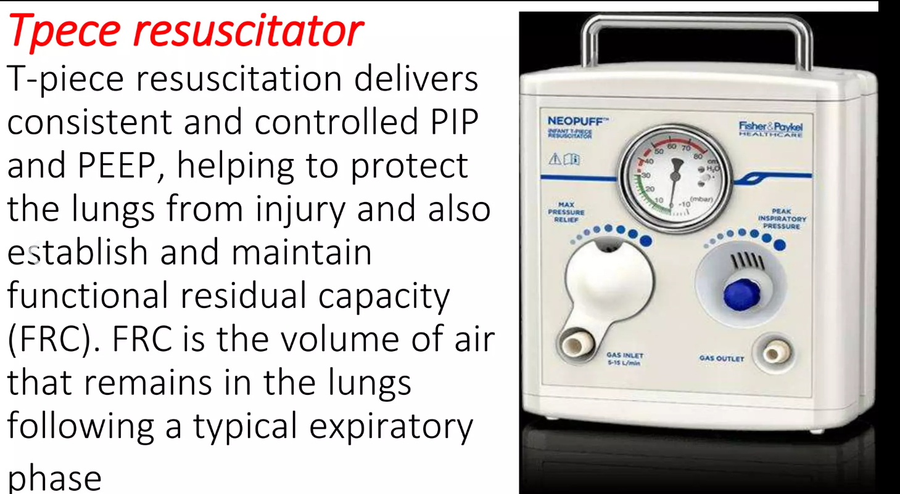

Slide 74
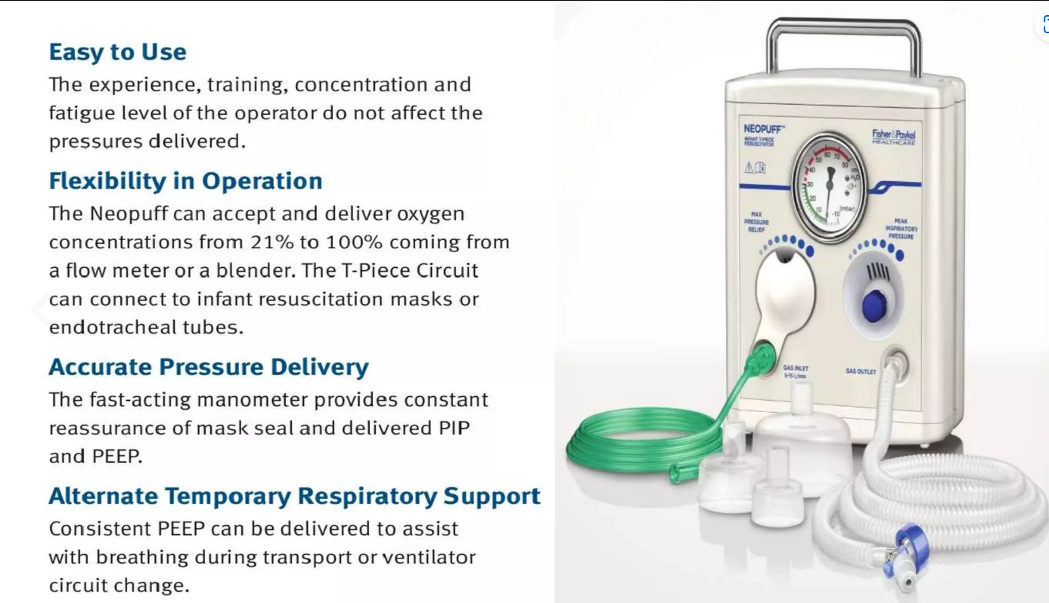

Slide 75
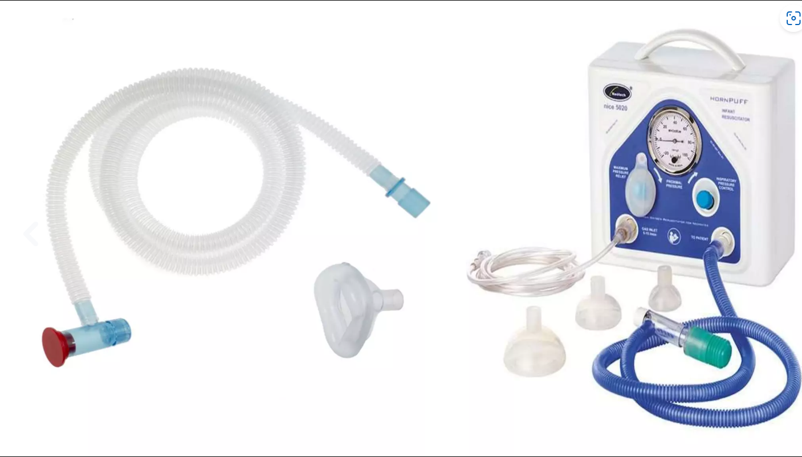

Slide 76
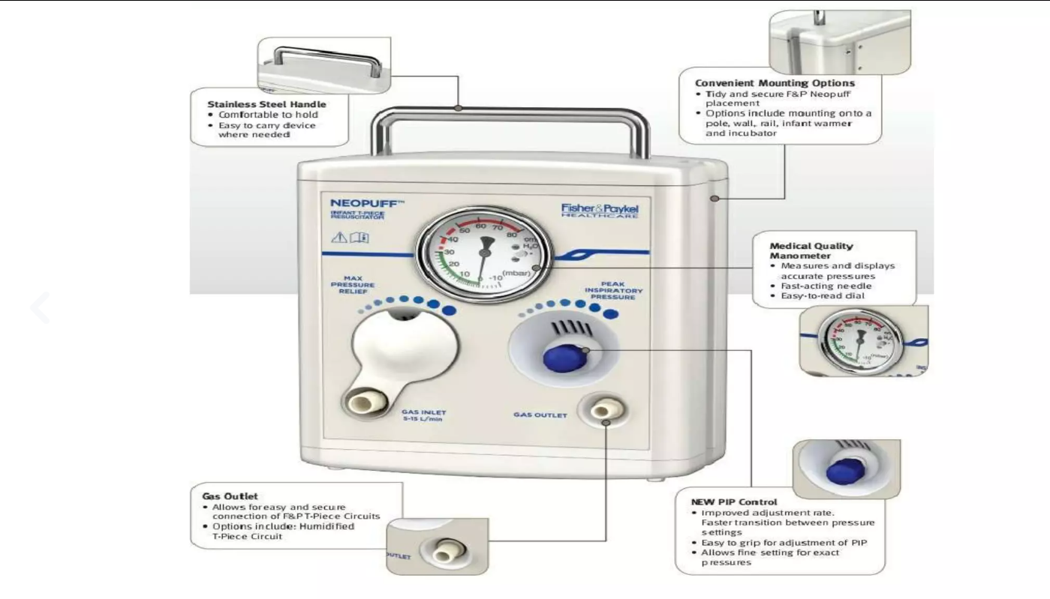

Slide 77
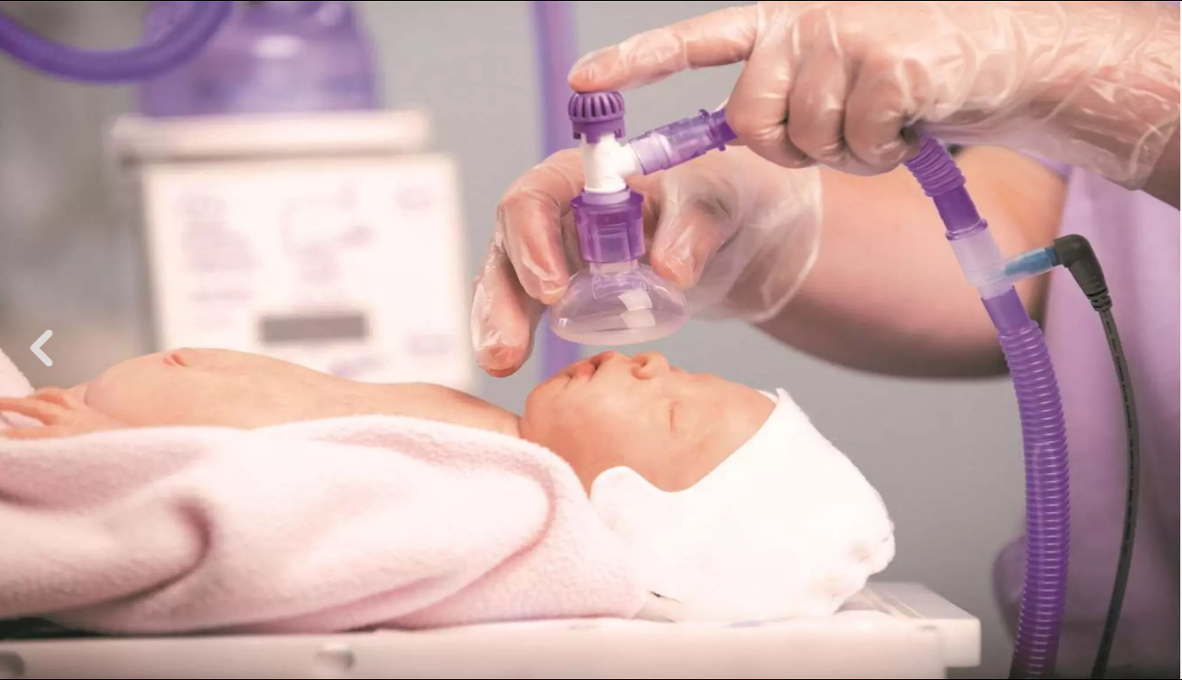

Slide 78
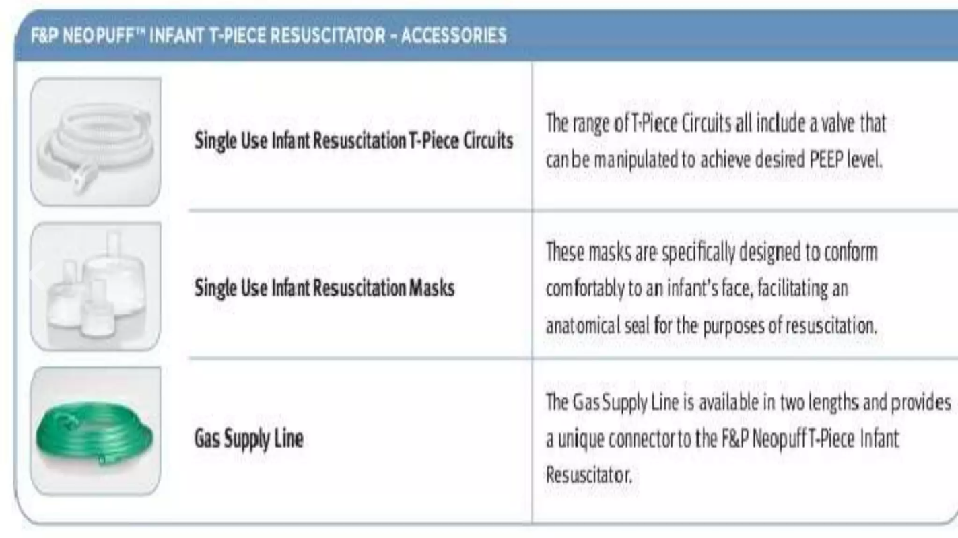

Slide 79
THANK YOU

